Slide 1


SMART INDIA HACKATHON 2026
UNMASK — THREAT INTELLIGENCE SOLUTION
  Problem Statement ID - 26151
  Problem Statement Title- Dark Web Threat Actor De-anonymization
  Theme- Blockchain & Cybersecurity
  PS Category- Software
  Team ID - SIH26151
  Team Name : ROOTX

Slide 2







RootX
IDEA TITLE
UNMASK : AI-Powered Threat Actor De-anonymization
→
→
→
DATA INGESTION
NLP ENTITY EXTRACTION
BEHAVIORAL CORRELATION
VISUAL THREAT GRAPH
Dark web forums,
markets & leak sites
spaCy NER — aliases,
wallets, PGP keys
Scikit-Learn cross-
platform ID linking
Neo4j + React Flow
actor network map
DETAILED EXPLANATION
HOW IT ADDRESSES THE PROBLEM
CORE INNOVATIONS (USP)
AI-Powered Extraction
Multi-Signal Correlation
spaCy NLP pipeline auto-extracts usernames, wallets, PGP keys & linguistic fingerprints from unstructured text.
✖ BEFORE
Manual, siloed monitoring — analysts miss cross-platform links between anonymous actors.
Fuses linguistic, behavioral & transactional signals — no single-source tool can match it.
Behavioral Correlation
↓
Unmask analyst AI
Scikit-Learn models correlate writing style & posting patterns to link pseudonymous identities to one actor.
✔ AFTER
Automated AI-driven correlation reveals hidden actor networks instantly, end-to-end.
Every risk score is justified & analyst-trustworthy, not a black box.
AI Risk Scoring
Investigation Pivoting
Explainable AI generates a transparent, evidence-backed threat score — no black-box verdicts.
Click-to-expand graph — pivot instantly from one actor to their entire network.
@SIH Idea submission- Template
2
Notes:
2

Slide 3

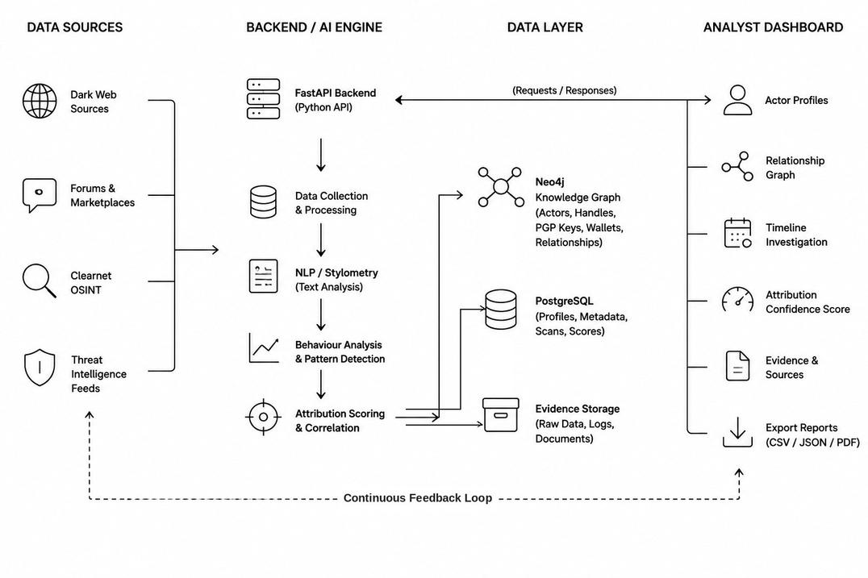
TECHNICAL APPROACH
RootX
TECHSTACK
ARCHITECTURE
  Frontend : React.js, Next.js, CSS
  Backend : Python + FastAPI
  AI/ML : Python, Scikit-learn
  Blockchain Analysis: Web3 / Blockchain APIs
  OSINT : Tor-compatible data sources + APIs
  Database : PostgreSQL & Neo4j
  Visualization : Chart.js & React Flow
@SIH Idea submission- Template
3
Notes:
3

Slide 4
FEASIBILITY AND VIABILITY
RootX
Feasibility & Viability
  Technically Feasible : Uses existing AI, OSINT, blockchain and cybersecurity technologies.
  Cost Effective : Can be developed using open-source tools and public threat data.
  Scalable: Can handle increasing users, transactions and threat data.
  Viable: Useful for law enforcement, CERTs and cybersecurity teams for early threat detection.
Challenges & Risks
  Dark-web data is unstable and difficult to collect.
  False positives, encryption and large data volumes can affect accuracy.
  Privacy, legal and ethical concerns must be managed.
Strategies
  Combine multiple intelligence sources for better accuracy.
  Use AI-based risk scoring instead of direct assumptions.
  Continuously update threat data and maintain secure, isolated monitoring.
@SIH Idea submission- Template
4
Notes:
4

Slide 5
IMPACT AND BENEFITS
RootX
Potential Impact
  SOC teams : Faster detection and prioritization of cyber threats.
  Cyber Forensics : Helps trace threat actors and analyze digital evidence.
  Law Enforcement : Supports investigation of dark-web activities.
  Organizations : Improves proactive threat monitoring and response.
Benefits
  Social : Improves overall digital safety.
  Economic : Helps reduce losses from cybercrime.
  Security : Enables early detection and faster incident response.
  Operational : Reduces manual effort in threat analysis.
@SIH Idea submission- Template
5
Notes:
5

Slide 6
RESEARCH AND REFERENCES
RootX
Core Research Domains Applied
  Graph-Based CTI: Methodologies for visualizing Cyber Threat Intelligence using node-edge structures.
  Behavioral Stylometry: Advanced NLP techniques for authorship attribution and text pattern matching.
  Entity Resolution: Algorithmic approaches to linking fragmented identities across Open Source Intelligence (OSINT).
Industry Frameworks & Data Sources
  MITRE ATT&CK Framework: Baseline for modeling threat actor tactics and techniques.
  NIST Cybersecurity Framework: Core guidelines for threat detection and anomaly reporting.
@SIH Idea submission- Template
6
Notes:
6

